Slide 1

Schrat
Ein Labyrinth Puzzle Spiel
Pascal Felber, Sebastian Riedi 2017
Notes:
Sebastian

Slide 2
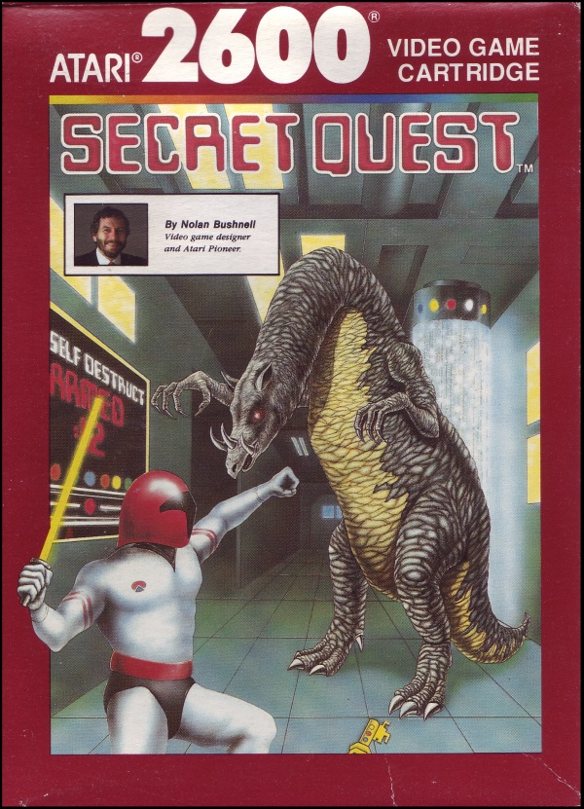
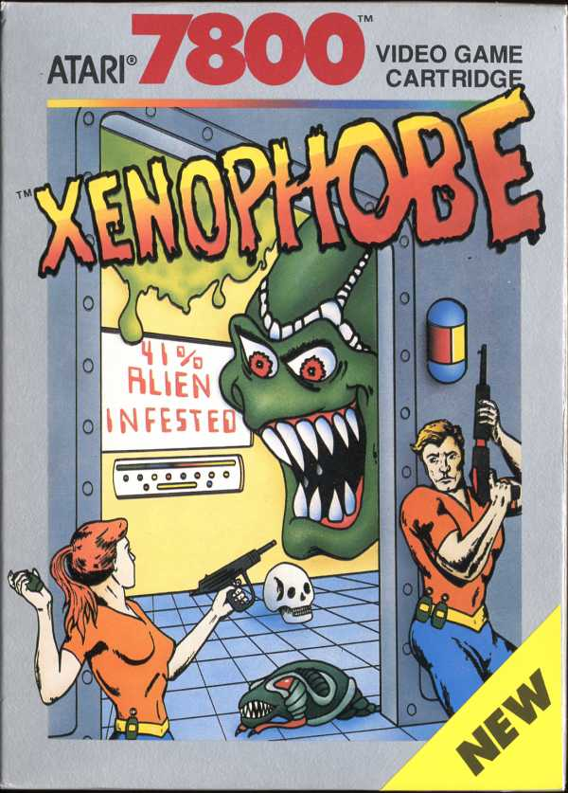
Basic Concepts
Inspiration
Notes:
Pascal

Slide 3
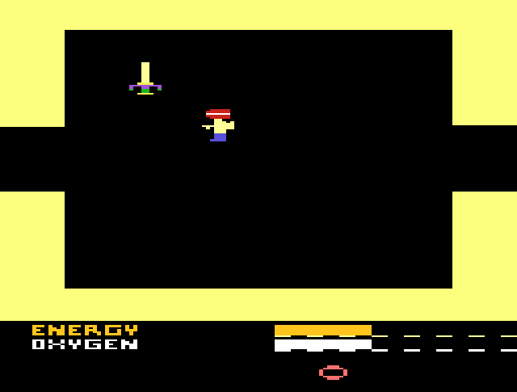
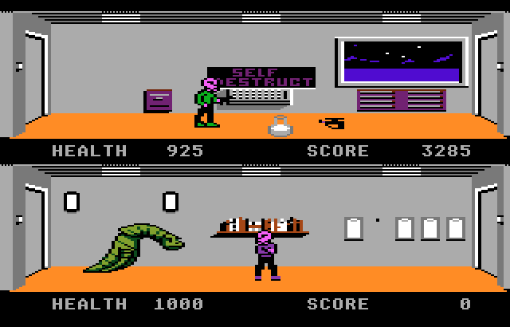
Basic Concepts
Secret Quest (Atari 2600)
Xenophobe (Atari 7800)
Labyrinth
Orienteering
Limited Player Resources (Oxygen)
Enemy development
Character Visuals
Fluent Animations
Notes:
Pascal

Slide 4
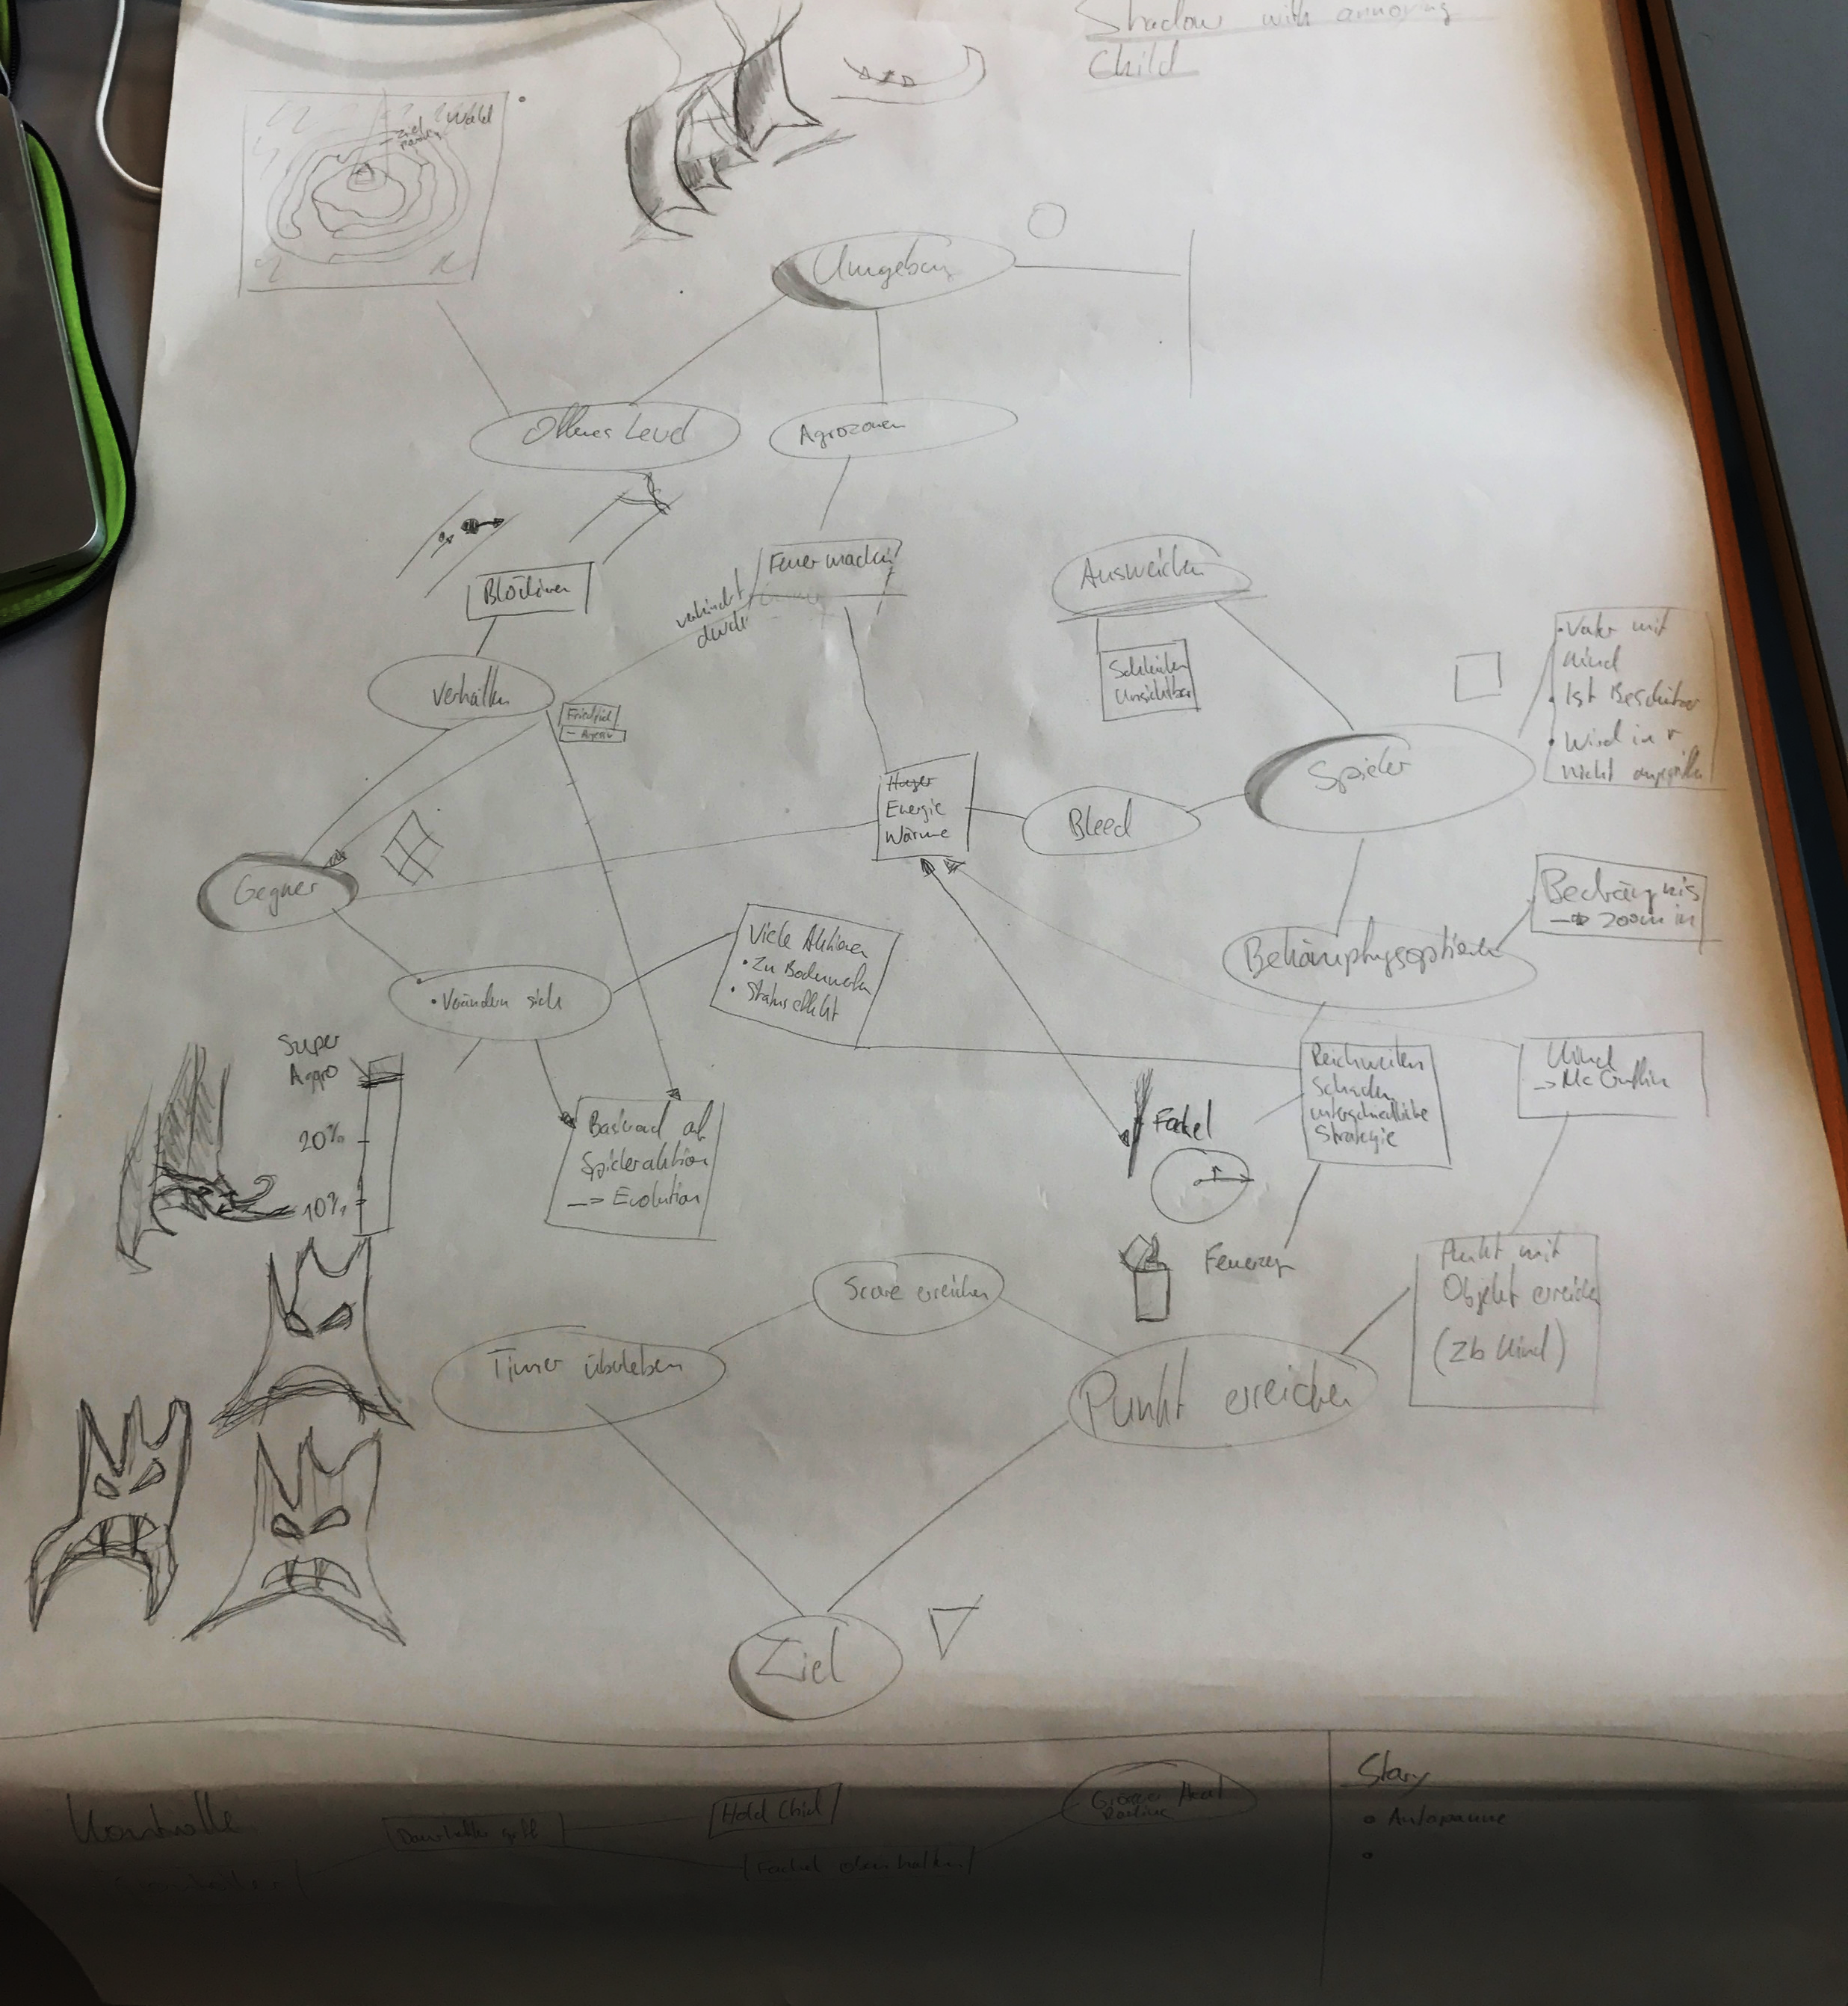
Mechanics Process
Connecting the Different Mechanics between player, enemy.
Also some random doodling…
Notes:
Sebastian

Slide 5
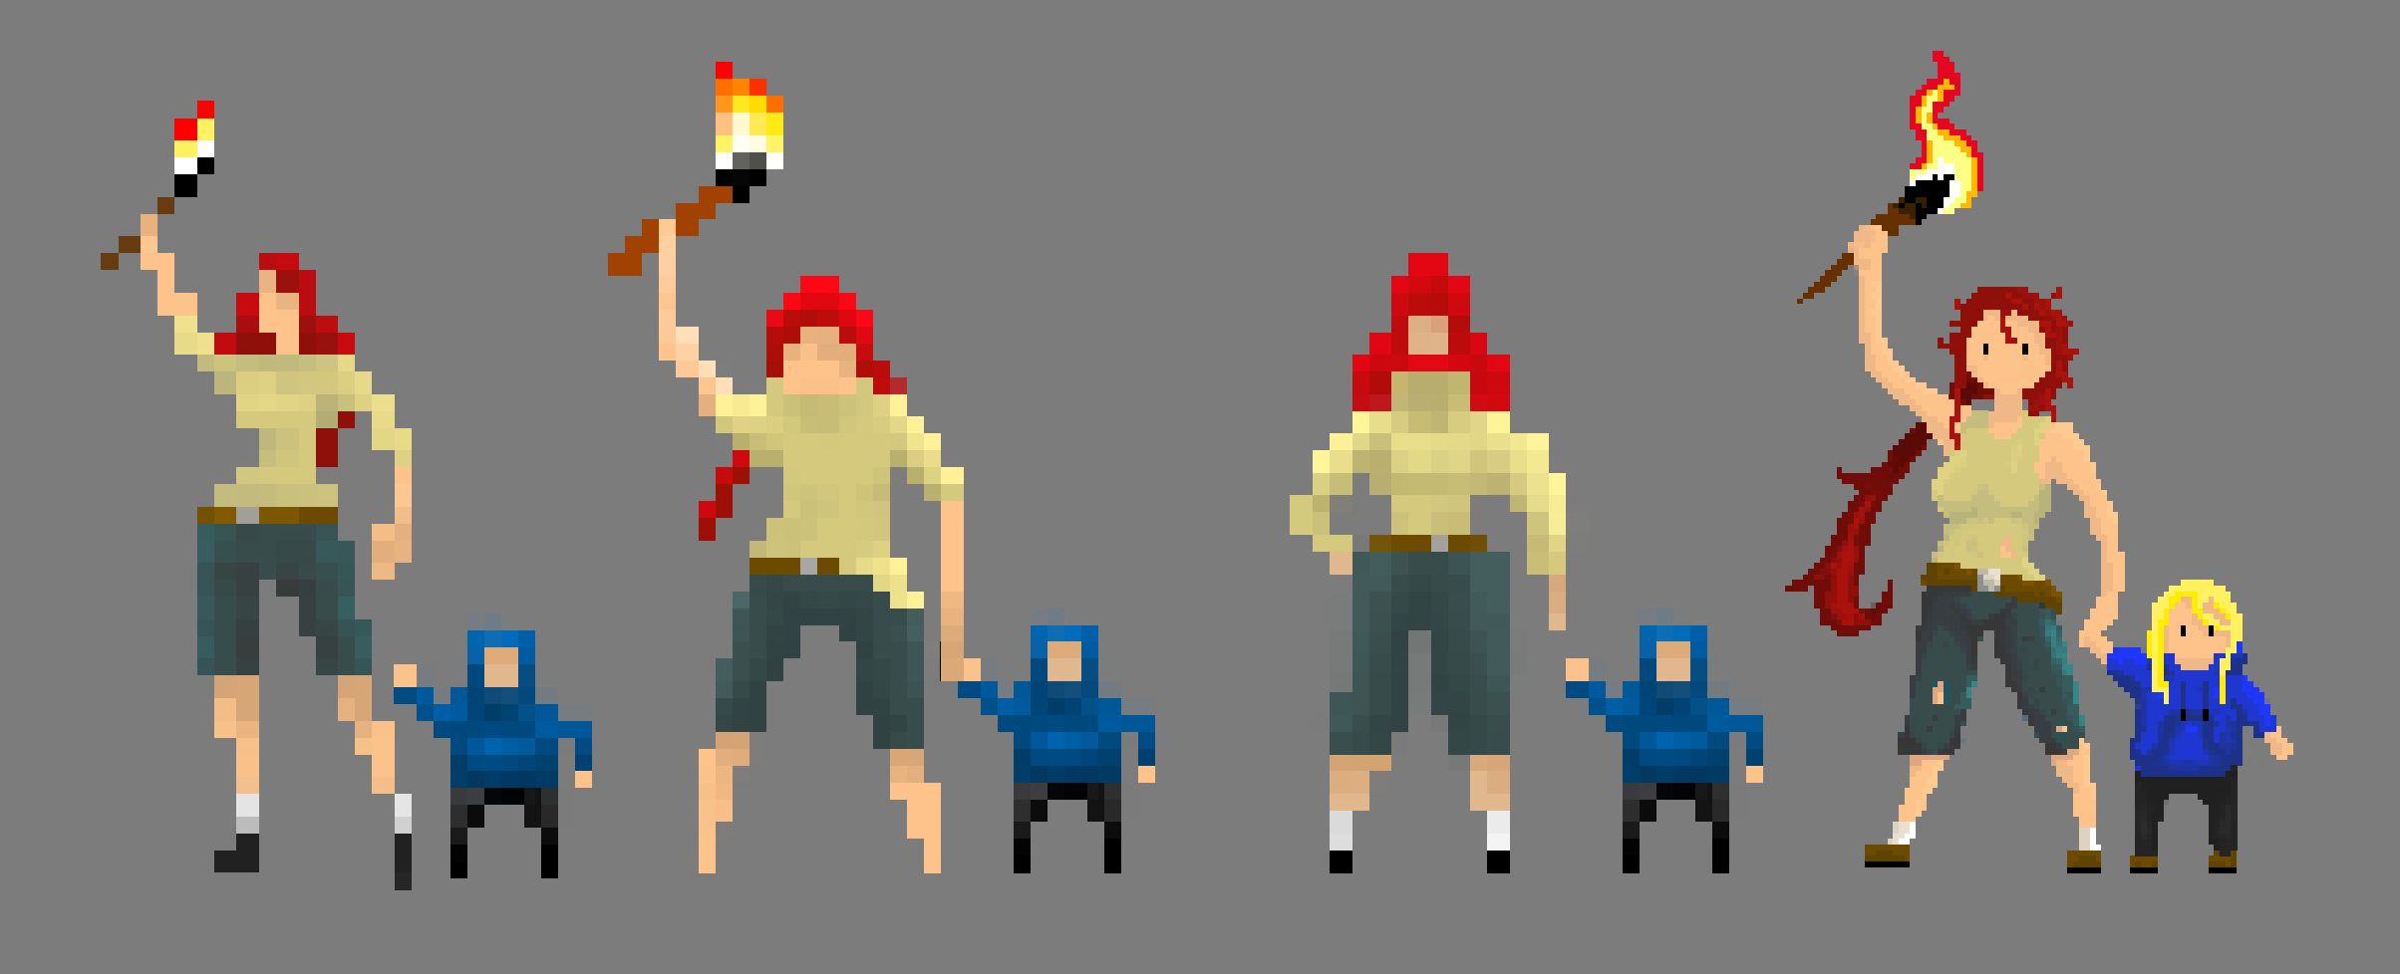
Game Visuals
Characters
Increasing Pixel deduction
Notes:
Pascal

Slide 6
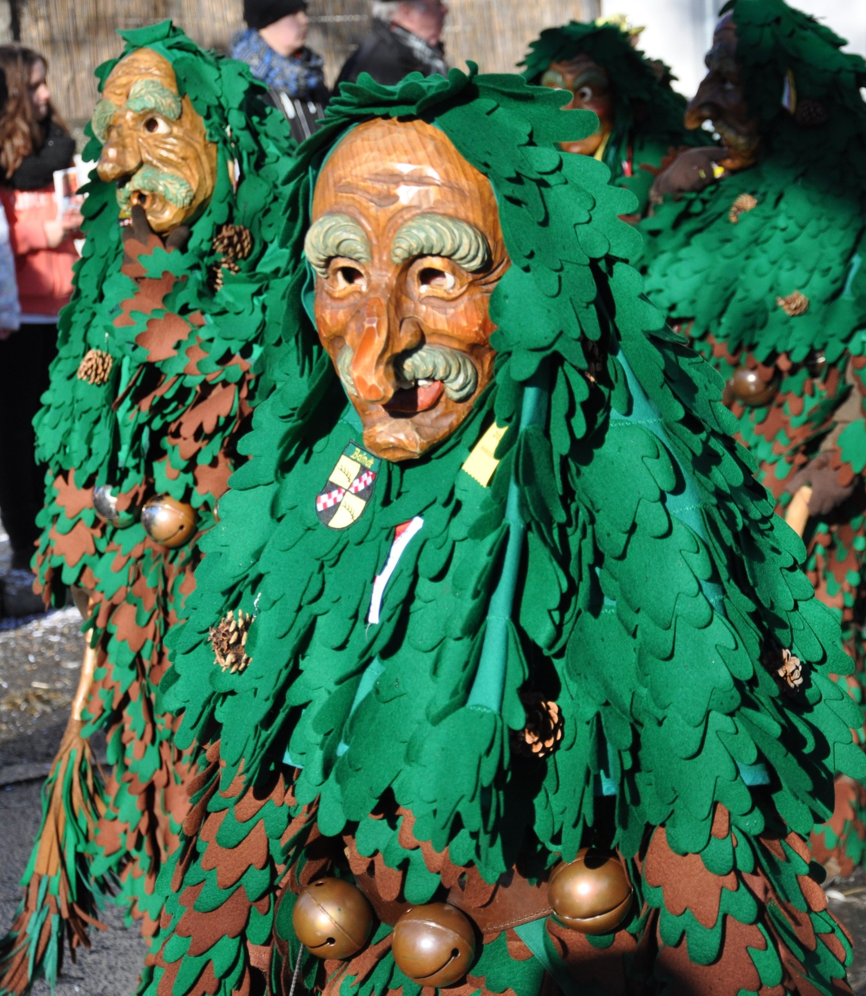
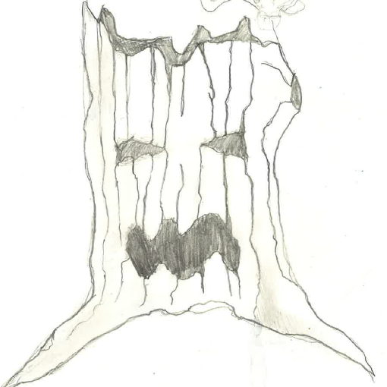
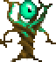
Game Visuals
Enemy Design and Inspiration
Notes:
Pascal

Slide 7
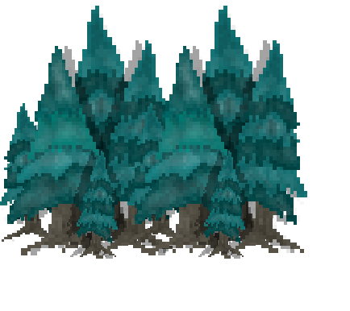
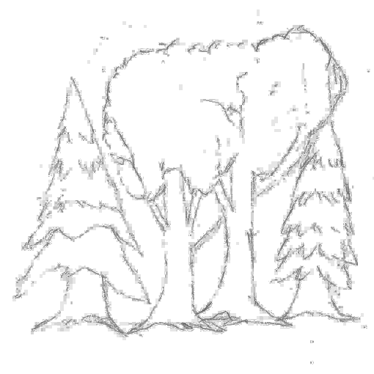
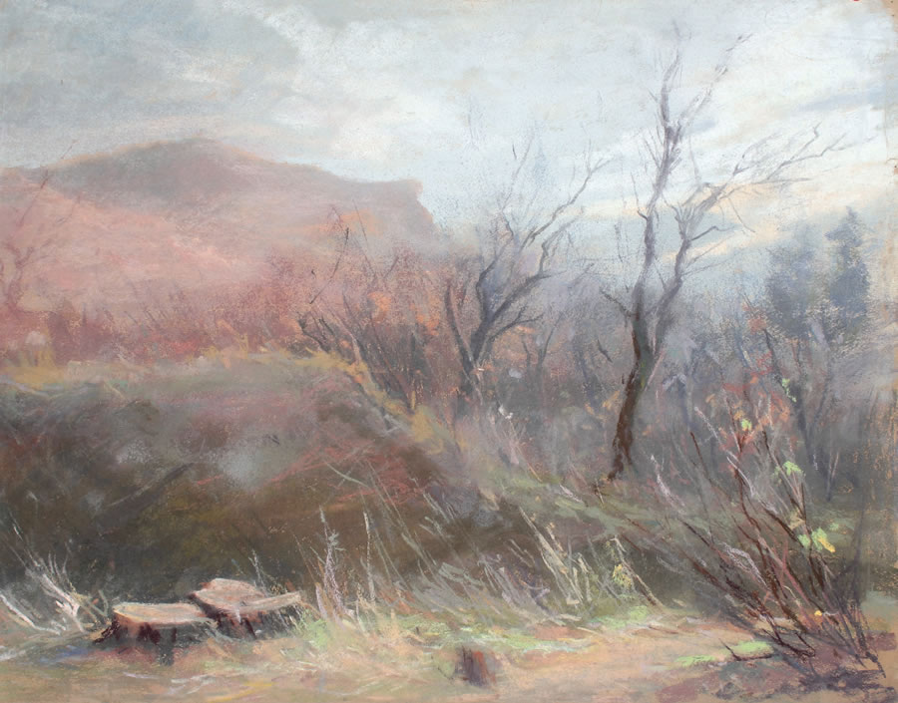
Game Visuals
Cold Surroundings
Cold Color Shades
Pastell Look
Notes:
Sebastian

Slide 8
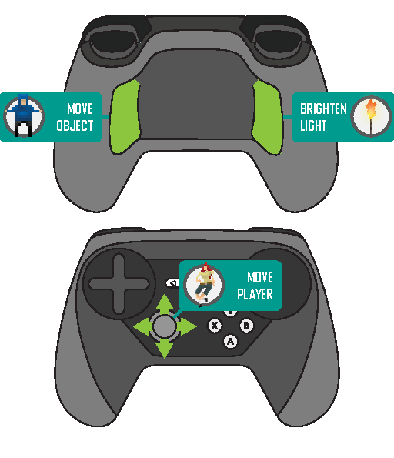
Controls & Stess
Physical Stress
Grip-Buttons of the Steam Controller
Feel of a Chase
Extortion
Notes:
Sebastian

Slide 9

Let’s play

